Slide 1

Economic
Climate
Study
2017
Presented November 3, 2017
Cambria Regional Summit
Researchers:
John McGrath, Ph.D.
Skip Glenn
Research Assistant:
Edwin Kesslak

Slide 2

Economic
Climate
Study
24th Year
Objectives:
  To fill a major gap
  in economic data
  To measure your attitudes
  about the future
  To track and compare
  data over time
Background

Slide 3
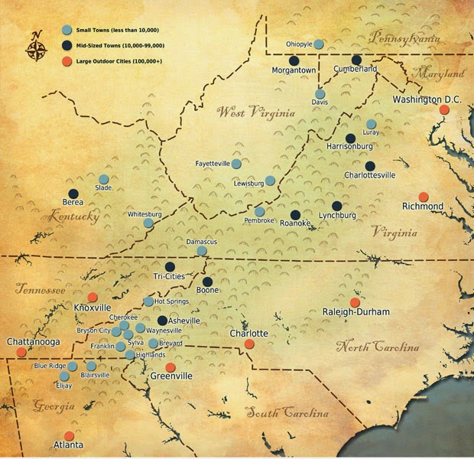

03
Spotlight
Again
THIS YEAR
QUALITY OF LIFE INDEX
  Johnstown’s overall score versus peer “Mountain Towns”
MOUNTAIN
TOWNS
Notes:
Regions including:
Cumberland, MD
Altoona, PA
Pittsfield, MA
Burlington, VT
Roanoke, VA
Ashville, NC

Slide 4


SURVEY METHOD
563
21%
118
MEMBERS
RESPONSE RATE
TOTAL SAMPLE
+
Notes:
4.0% of all businesses in Cambria County (3,286)
Sampling error estimate: +/- 8.4% for all businesses sample
Sampling error estimate: +/- 7.5% for Chamber member sample
Sources: US Census Bureau, 2014 total employee establishments; DSS Research Error Estimate Calculator, 2016

Slide 5
03
  2018 Projections
    Revenues
    Profits
    Capital Spending
FINANCIAL
FORECAST

Slide 6
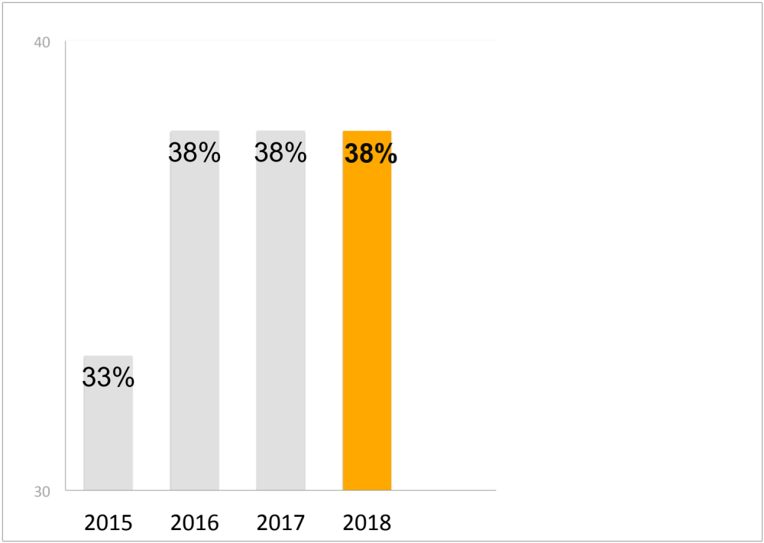

REVENUE FORECAST
2018
0%
Points
30%
NO CHANGE vs. Last Year
38% predict revenue
increases of 3% or more
17%
Reality Check:
41% of PA firms expect revenue increases
Percent projecting 3% increases or more
12%

Slide 7
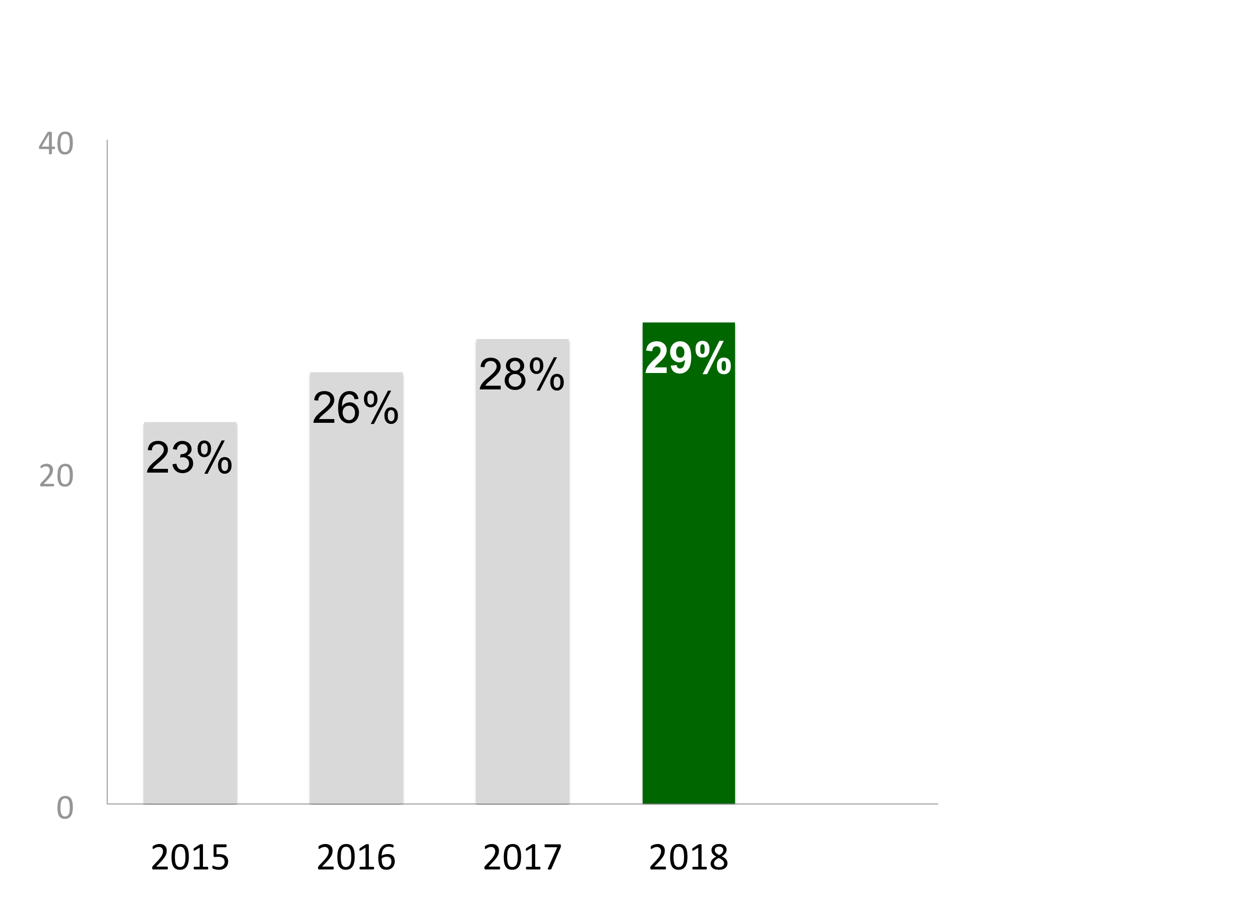
PROFIT FORECAST
2018
1%
point
30%
UP vs. Last Year
29%
predict profit
increases of 3% or more
17%
Percent projecting 3% increases or more
12%

Slide 8
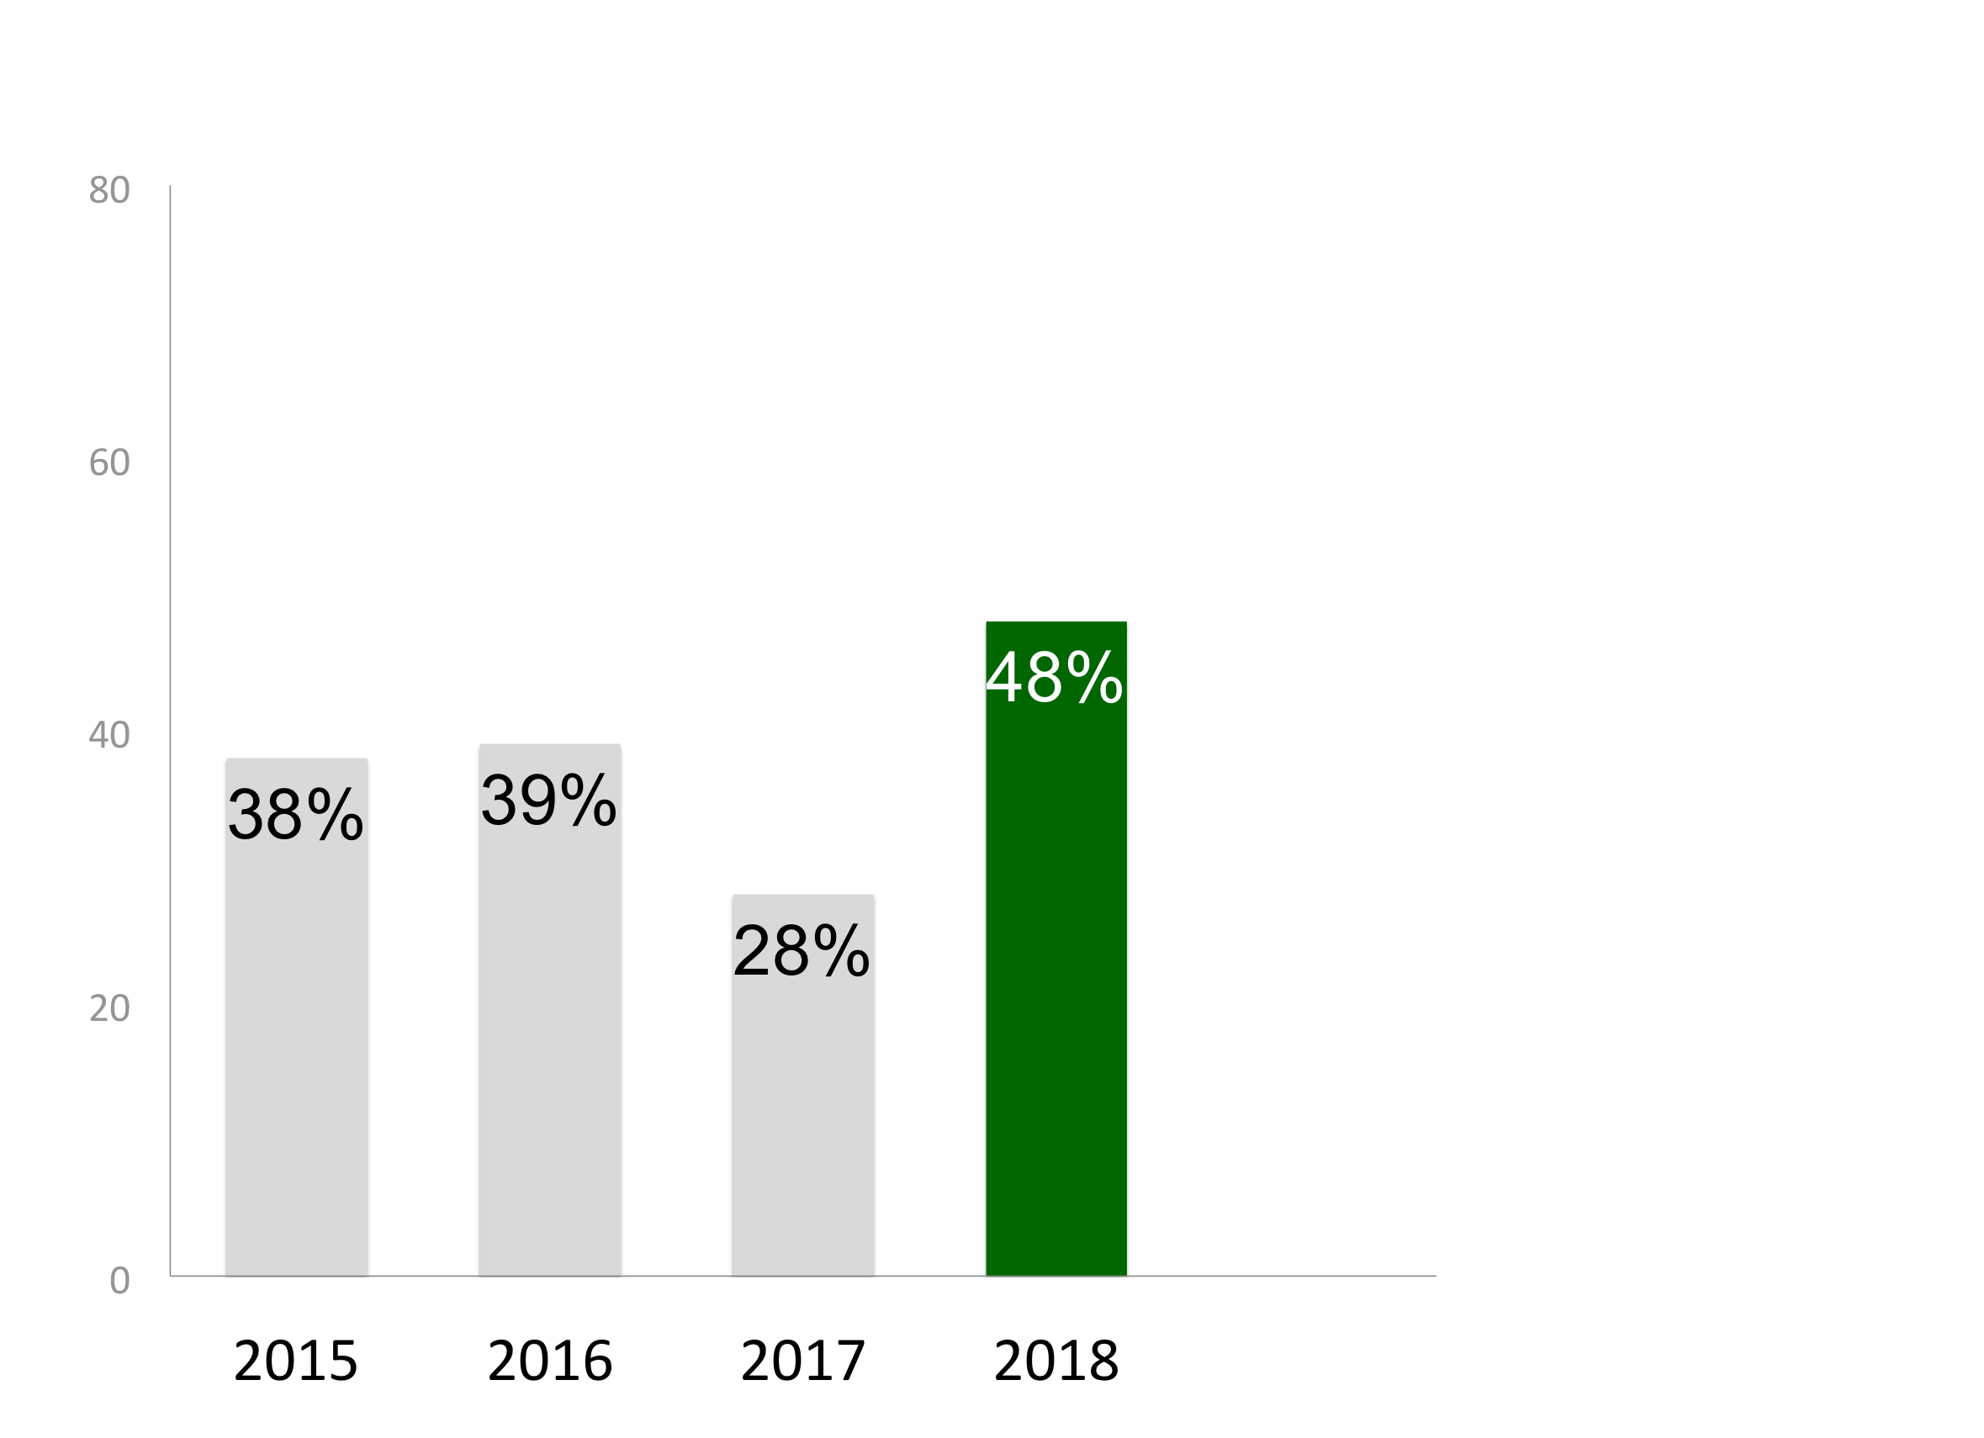
CAPITAL SPENDING FORECAST
2018
DOWN vs. last year
20%
points
30%
UP vs. Last Year
48% predict increases
17%
Reality Check:
55% of PA firms plan to increase capital spending
Percent reporting capital spending increases
12%

Slide 9
03
  2017 Actual Data
    Unemployment Rate
    Employment Growth
EMPLOYMENT
STATUS

Slide 10
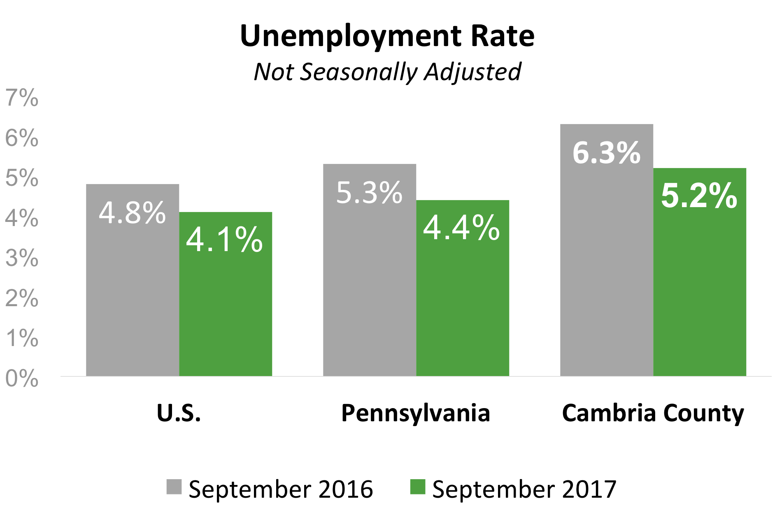
UNEMPLOYMENT RATE
2016-2017
Johnstown’s rate has improved, but is still higher than PA and the U.S.
30%
17%
12%
Source: U.S. Bureau of Labor Statistics, Bill Findley, November 2017

Slide 11
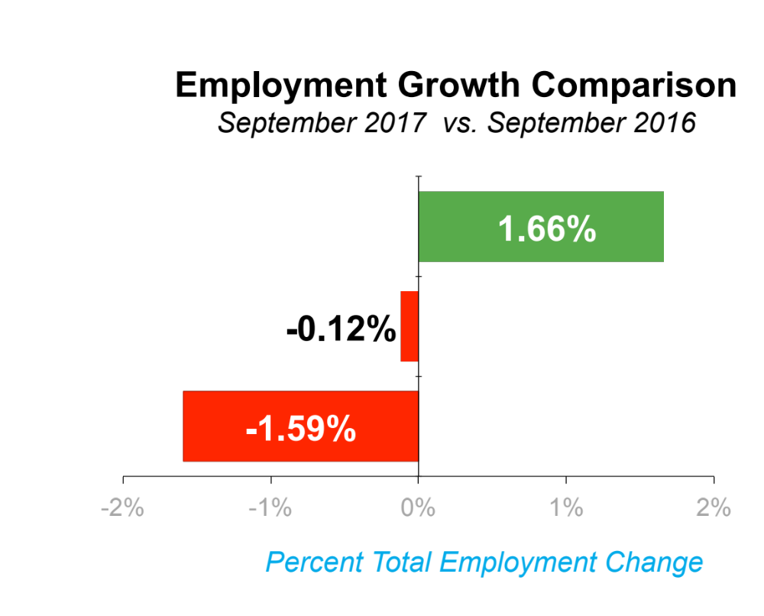

EMPLOYMENT GROWTH
2016-2017
Johnstown’s employed work force lost ground again in 2017
30%
U.S.
Pennsylvania
17%
Cambria County
12%
Source: U.S. Bureau of Labor Statistics, Bill Findley, November 2017

Slide 12
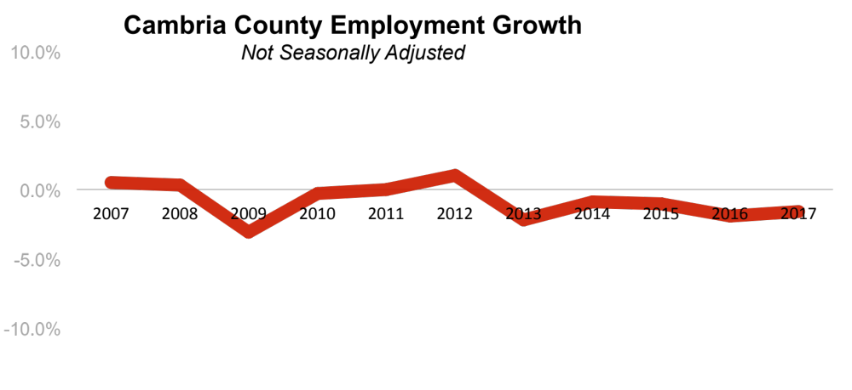
EMPLOYMENT GROWTH TREND
2007-2017
30%
17%
Johnstown’s job growth is flat
12%
Source: U.S. Bureau of Labor Statistics, Bill Findley, November 2017

Slide 13
03
  2018 Projections
    Overall
    By type of position
    By industry
    By type of firm
    By size of firm
JOBS FORECAST

Slide 14
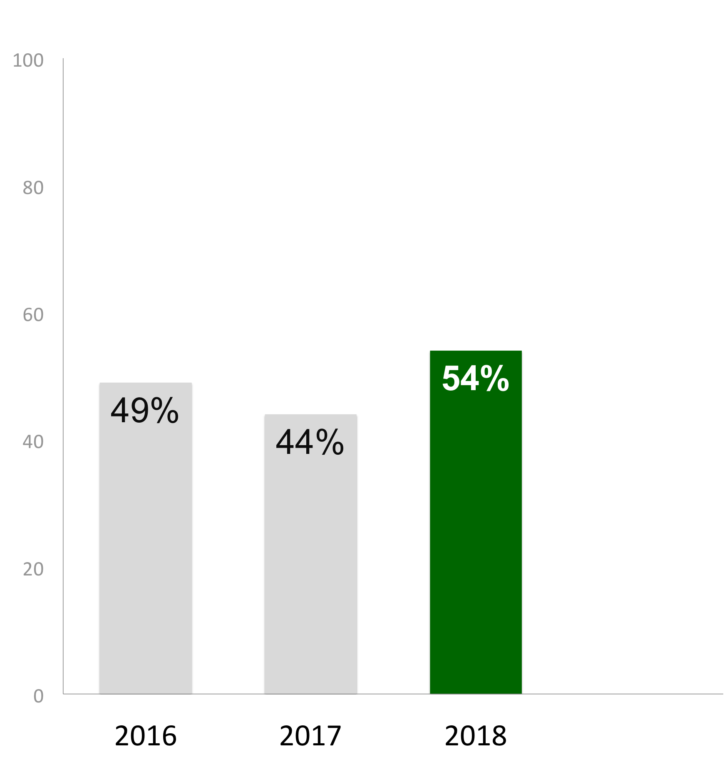
JOBS FORECAST
2018
10%
points
30%
UP vs. Last Year
54% plan to hire in 2018
17%
Reality Check:
22% of PA firms expect to hire in 2018
12%
Percent reporting hiring plans

Slide 15
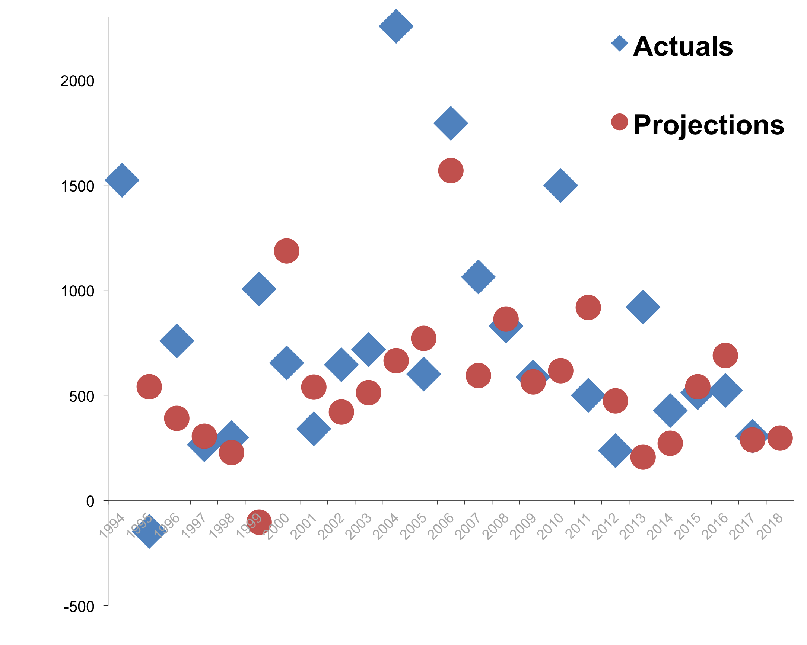
JOB GROWTH PROJECTION
1994-2017
3%
UP vs. Last Year
2017 – 289
2018 – 297

Slide 16
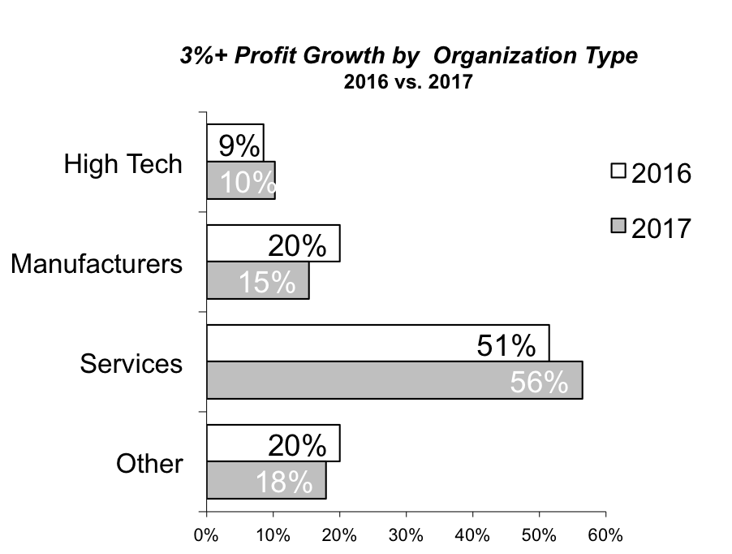
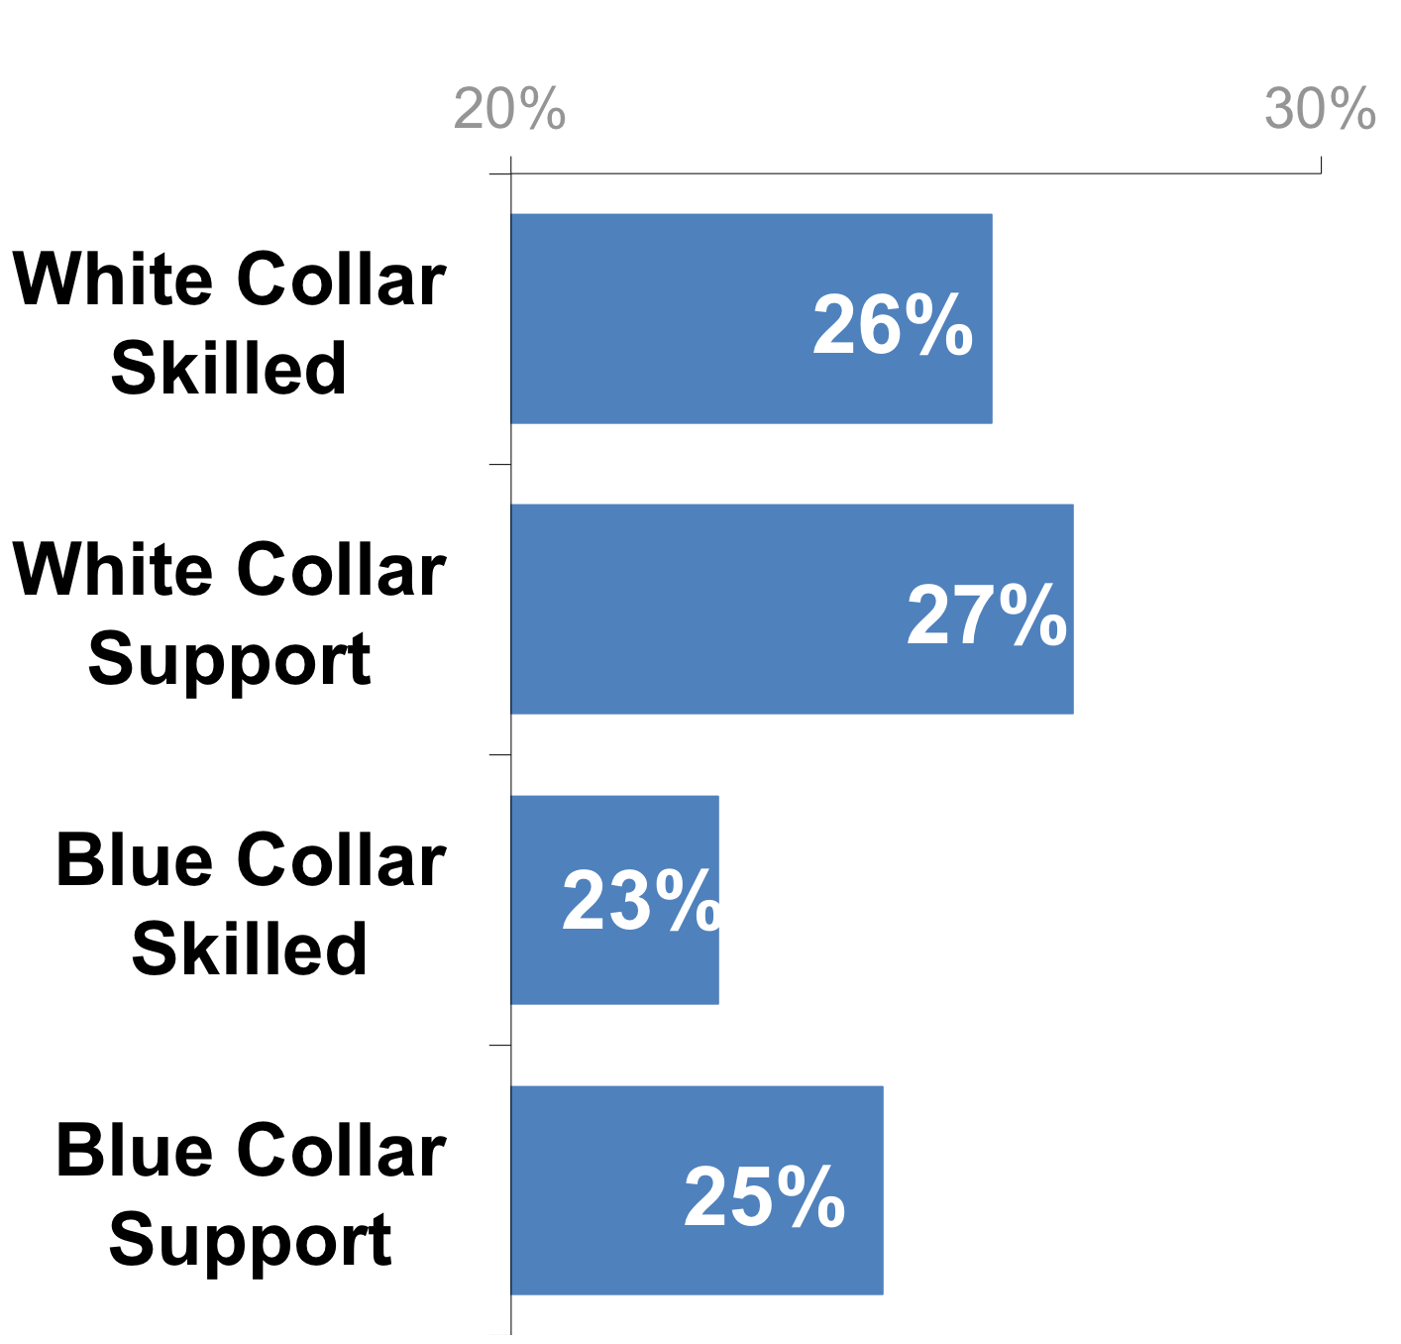
JOBS BY POSITION
2018
Predicted growth is balanced across
job types
Percent of projected 2018 jobs

Slide 17
JOBS BY ORGANIZATION TYPE
2018
Services account for most of the predicted growth
Percent of projected 2018 jobs

Slide 18
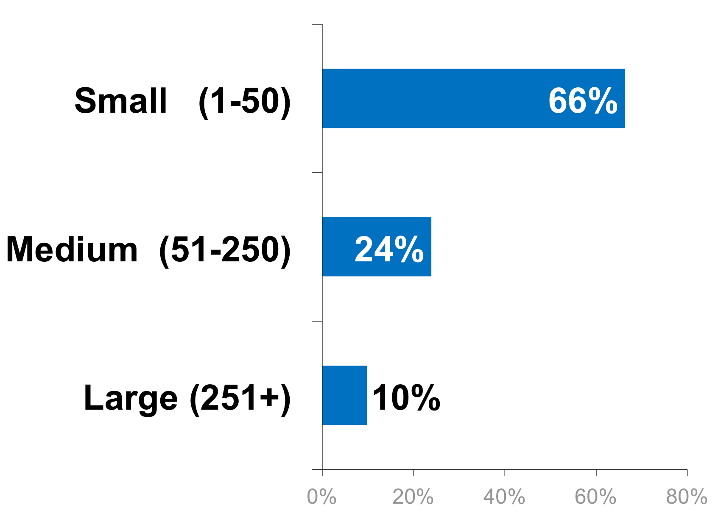
JOBS BY ORGANIZATION SIZE
2018
Small organizations are predicted to be the dominant driver
Percent of projected 2018 jobs

Slide 19
03
  2017 Comparisons
    Region
    Pennsylvania
    United States
OPTIMISM

Slide 20
OPTIMISM SCALE
Our region is more optimistic than
PA or the U.S….
Moderately Optimistic
Very Optimistic
Pessimistic
U.S.*
29%
58%
12%
Pennsylvania*
28%
60%
12%
Our Region
13%
69%
18%
*Source: PNC Bank, October, 2017

Slide 21
OPTIMISM SCALE
…and much more optimistic than
last year
Pessimistic
Moderately Optimistic
Very Optimistic
Our Region:
2017
13%
69%
18%
Our Region:
2016
53%
43%
4%

Slide 22
03
  Regional Assets
    Environment
    Downtown
QUALITY OF LIFE

Slide 23
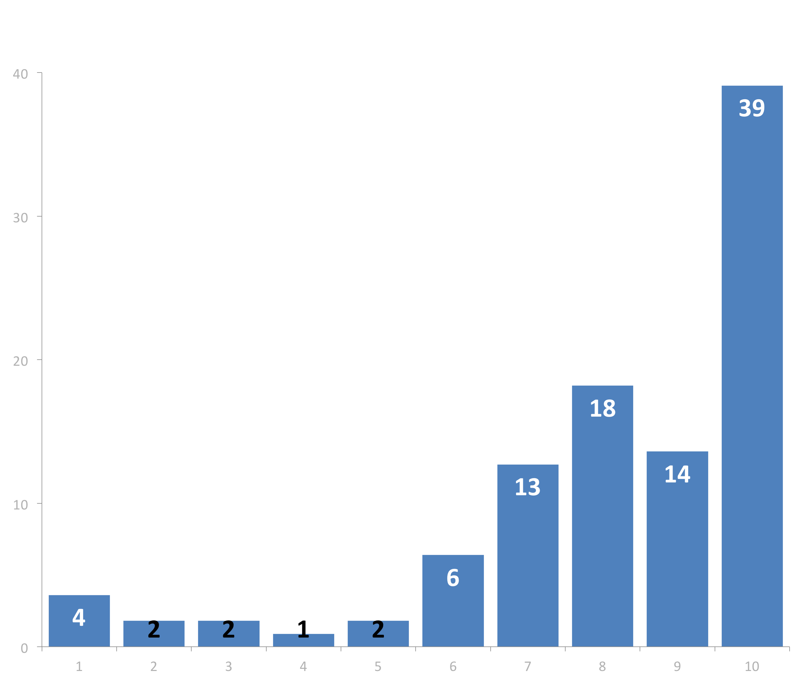
Importance of a Vital Downtown
Most think a vital downtown is critical to our region’s success
% Percent Responding
Not Important At All
Absolutely Critical

Slide 24
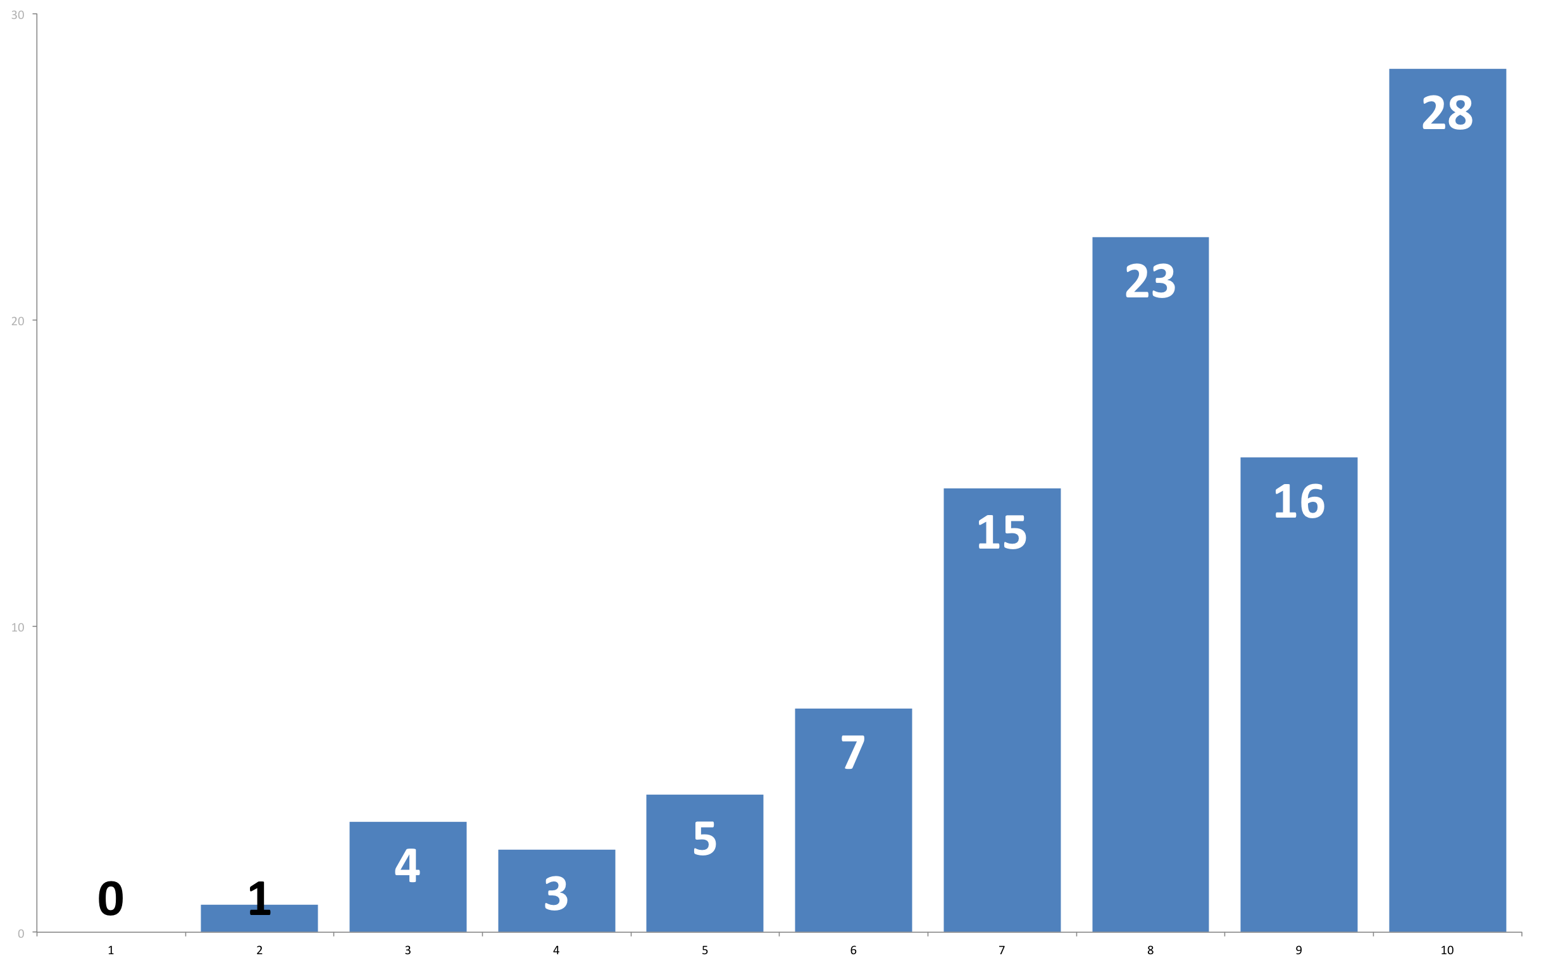
Importance Rivers and Trails
Most think our rivers and trails are also critical to our region’s success
% Percent Responding
Not Important At All
Absolutely Critical

Slide 25
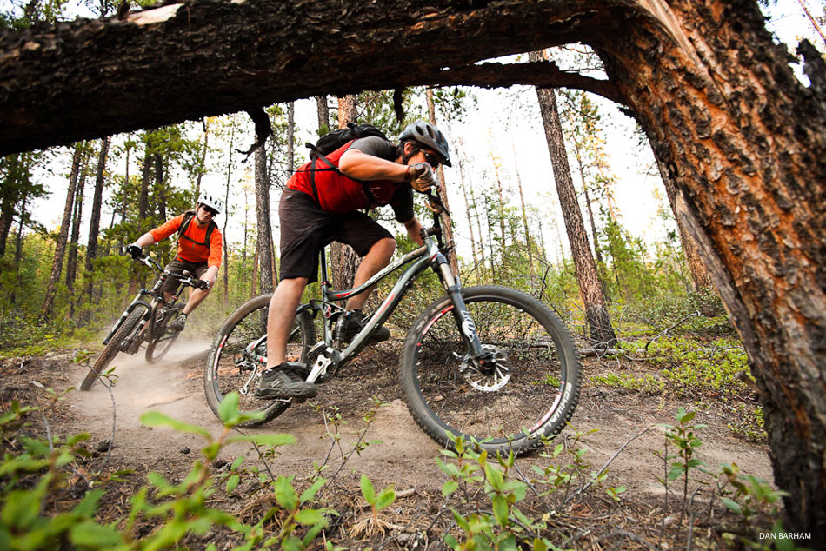
MOUNTAIN TOWNS
QUALITY OF LIFE INDEX
Notes:
Regions including:
Cumberland, MD
Altoona, PA
Pittsfield, MA
Burlington, VT
Roanoke, VA
Ashville, NC

Slide 26

Johnstown
Altoona
Wheeling
2025
15
Benchmark
Cities

Slide 27
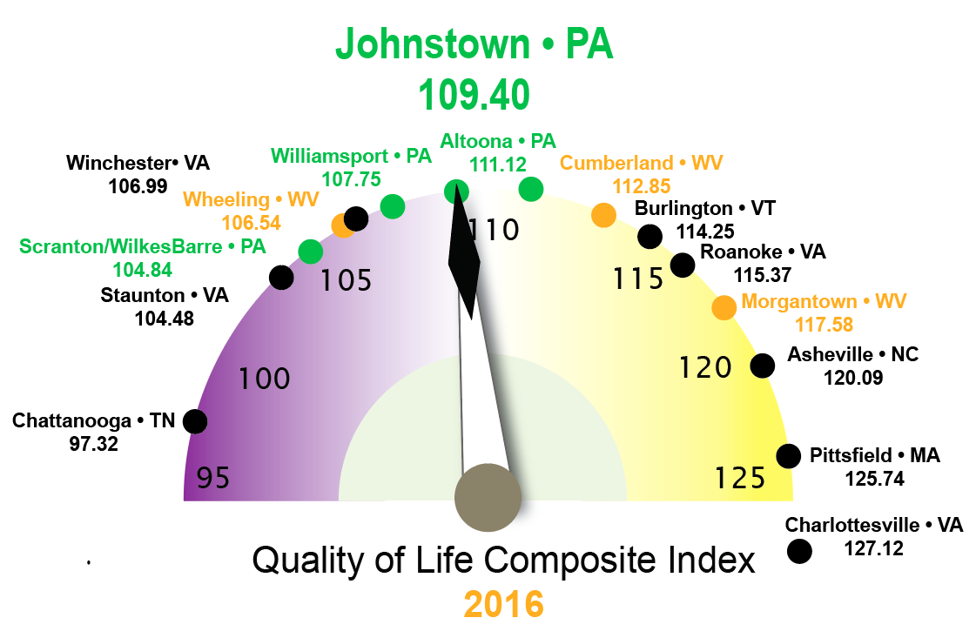
QUALITY OF LIFE • CITY COMPARISON
2016

Slide 28
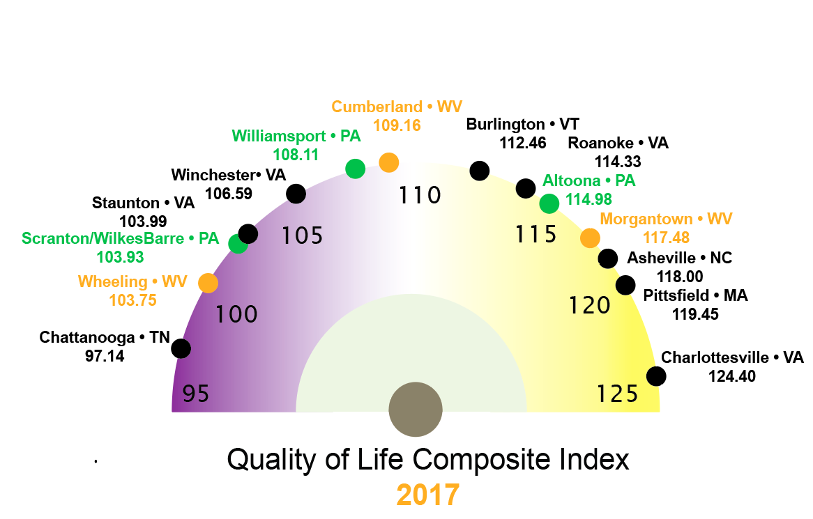
QUALITY OF LIFE • CITY COMPARISON
2017

Slide 29
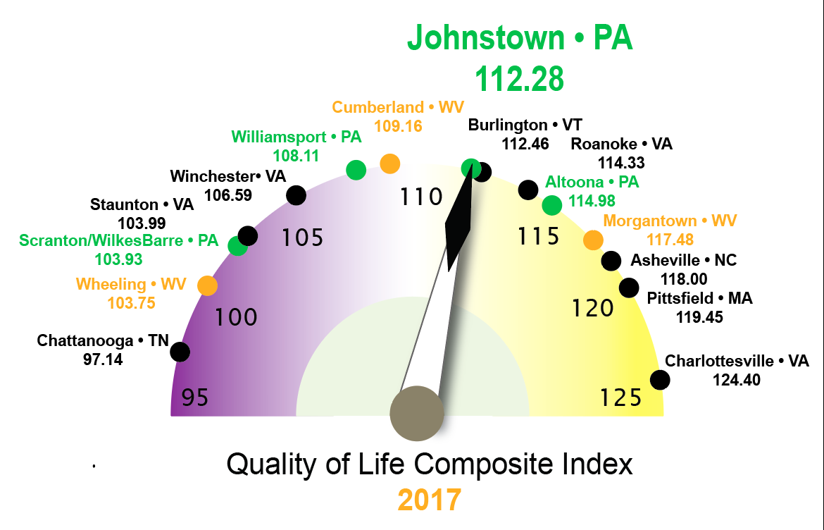
QUALITY OF LIFE • CITY COMPARISON
2017

Slide 30
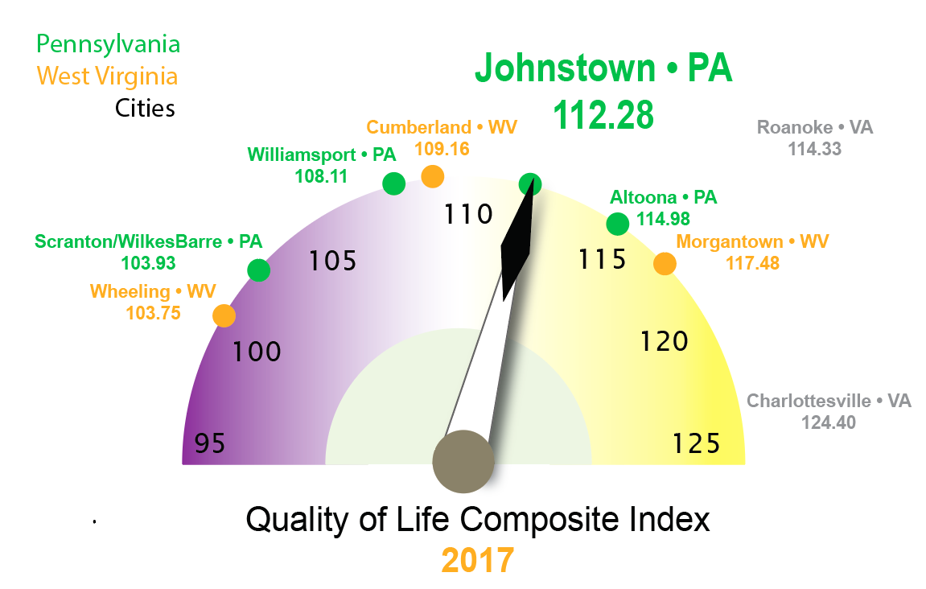
QUALITY OF LIFE • CITY COMPARISON
PA - 2017 - WV

Slide 31
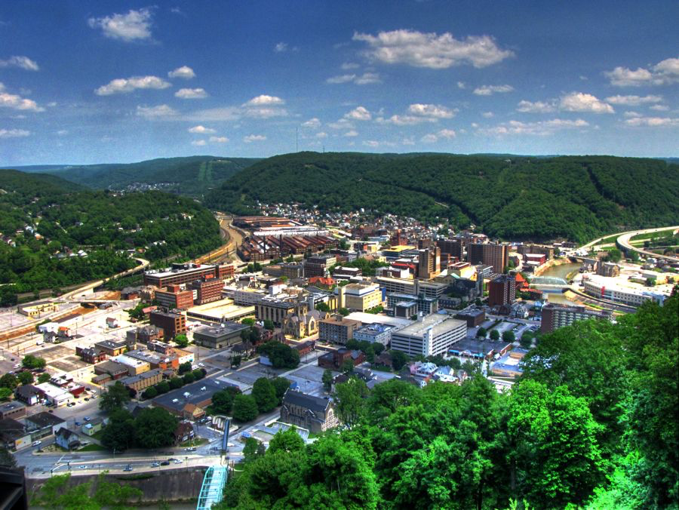
Moving the Needle Forward

Slide 32
?
Questions
Suggestions
Economic
Climate
Study
2017
Researchers:
John McGrath, Ph.D.
Skip Glenn
Research Assistant:
Edwin Kesslak

Slide 33
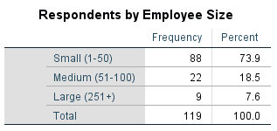
Appendix 1: Respondents by Number of Employees

Slide 34
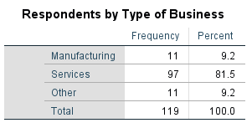
Appendix 2: Respondents by Type of Business

Slide 35
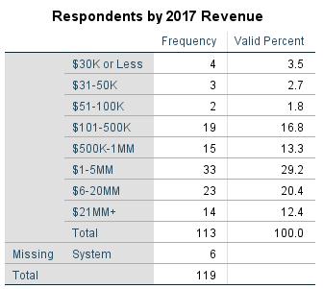
Appendix 3: Respondents by Revenue

Slide 36
Appendix 4: Historical Response Rate

