Slide 1




Economic
Climate
Study
2018
Rogue Researchers:
John McGrath, Ph.D.
Skip Glenn
Research Assistant:
Edwin Kesslak

Slide 2

Economic
Climate
Study
25th Year

Slide 3
Economic
Climate
Study
25th Year
Objectives:
  To fill a major gap
  in economic data
  To measure your attitudes
  about the future
  To track and compare
  data over time

Slide 4
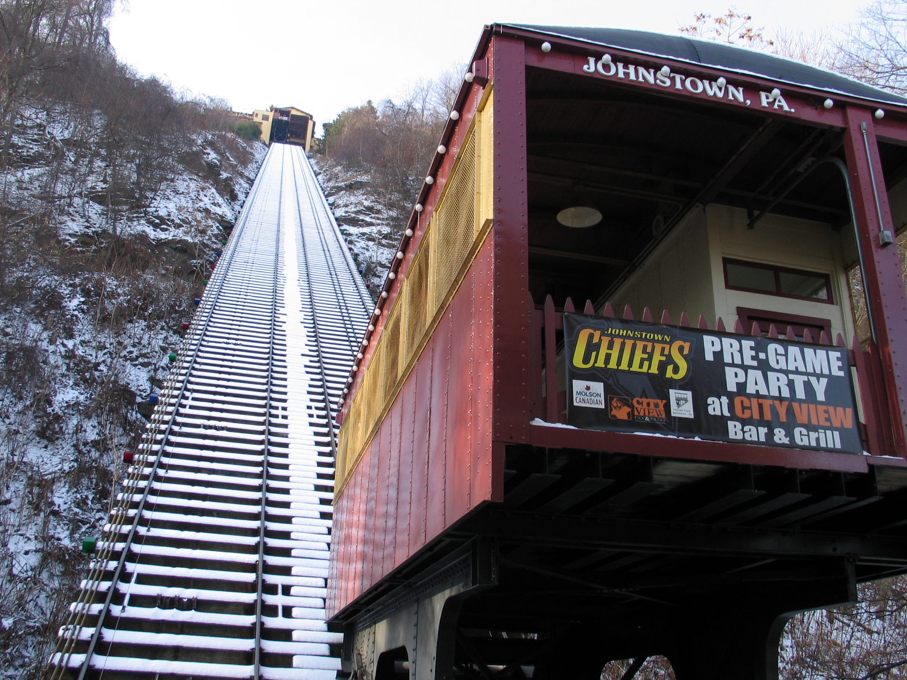


03
Spotlight
THIS YEAR
QUALITY OF LIFE
INDEX
  “Mountain Town
  Heritage”
Notes:
Regions including:
Cumberland, MD
Altoona, PA
Pittsfield, MA
Burlington, VT
Roanoke, VA
Ashville, NC

Slide 5



SURVEY METHOD
544
22%
121
MEMBERS
RESPONSE RATE
TOTAL SAMPLE
+
Notes:
Active + Prospects 426 + 114 = 540

Slide 6
03
  2019 Projections
    Revenues
    Profits
    Capital Spending
FINANCIAL
FORECAST

Slide 7
REVENUE FORECAST
2019
-1%
points
Down vs. Last Year
37% predict revenue
increases of 3% or more
17%
Reality Check:
44% of PA firms expect revenue increases
Percent projecting 3% increases or more

Slide 8
PROFIT FORECAST
2019
2% points
30%
UP vs. Last Year
29%
predict profit
increases of 3% or more
17%
Percent projecting 3% increases or more

Slide 9
CAPITAL SPENDING FORECAST
2019
4%
points
30%
UP vs. Last Year
52% predict increases
17%
Reality Check:
56% of PA firms plan to increase capital spending
Percent reporting capital spending increases

Slide 10
03
  2018 Actual Data
    Unemployment Rate
    Employment Growth
EMPLOYMENT
STATUS

Slide 11
UNEMPLOYMENT RATE
2017-2018
Johnstown’s rate has improved, but is still higher than PA and the U.S.
30%
17%
Source: U.S. Bureau of Labor Statistics, Bill Findley, November 2018

Slide 12

EMPLOYMENT GROWTH
2017-2018
Johnstown’s (and PA’s) employed work forcees lost ground again in 2018
U.S.
+1.10%
Pennsylvania
Johnstown
Source: U.S. Bureau of Labor Statistics, Bill Findley, November 2018

Slide 13
EMPLOYMENT GROWTH TREND
2007-2018
Johnstown’s job growth is flat
Source: U.S. Bureau of Labor Statistics, Bill Findley, November 2018

Slide 14
03
  2019 Projections
    Overall
    By type of position
    By industry
    By type of firm
    By size of firm
JOBS FORECAST

Slide 15
HIRING FORECAST
2019
46% plan to hire in 2019
DOWN vs. Last Year
8%
points
17%
Reality Check:
28% of PA firms expect to hire in 2019
Percent reporting hiring plans

Slide 16
JOB GROWTH PROJECTION
1994-2019
47%
UP vs. Last Year
2018 – 297
2019 – 436
Forecast
Actual

Slide 17
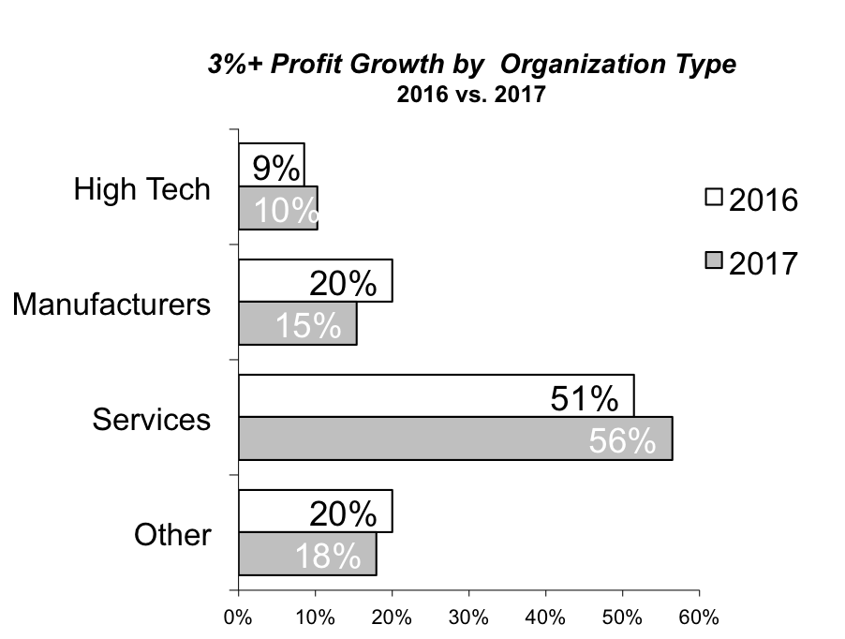
JOBS BY POSITION
2019
Predicted growth is led by Blue Collar Support positions
Percent of projected 2019 jobs

Slide 18
JOBS BY ORGANIZATION TYPE
2019
Services account for most of the predicted growth
Percent of projected 2019 jobs

Slide 19
JOBS BY ORGANIZATION SIZE
2019
Mid-sized organizations lead the predicted growth
Percent of projected 2019 jobs

Slide 20
03
  2019 Comparisons
    Region
    Pennsylvania
    United States
OPTIMISM

Slide 21
OPTIMISM SCALE
Our region is not as optimistic as the
PA or the U.S….
Moderately Optimistic
Very Optimistic
Pessimistic
U.S.*
13%
47%
40%
Pennsylvania*
10%
53%
37%
Our Region
13%
60%
27%
*Source: PNC Bank, October, 2018

Slide 22
03
  Regional Assets
    Importance of
    Central Park
QUALITY OF LIFE

Slide 23
Importance of Central Park
Mean 7.03
Most think a vital Central Park is critical to our region’s success
Not Important At All
Absolutely Critical
% Percent Responding

Slide 24
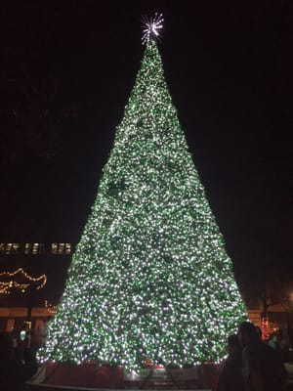
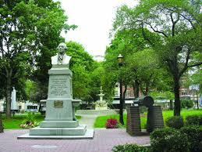
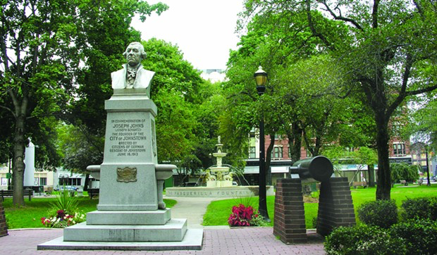
Central Park Suggestions
Most frequently mentioned ideas:
1) “Add more retail”
2) “Expand number of activities”
3) “Improve safety”

Slide 25

Central Park Suggestions
Zipline down the Incline

Slide 26
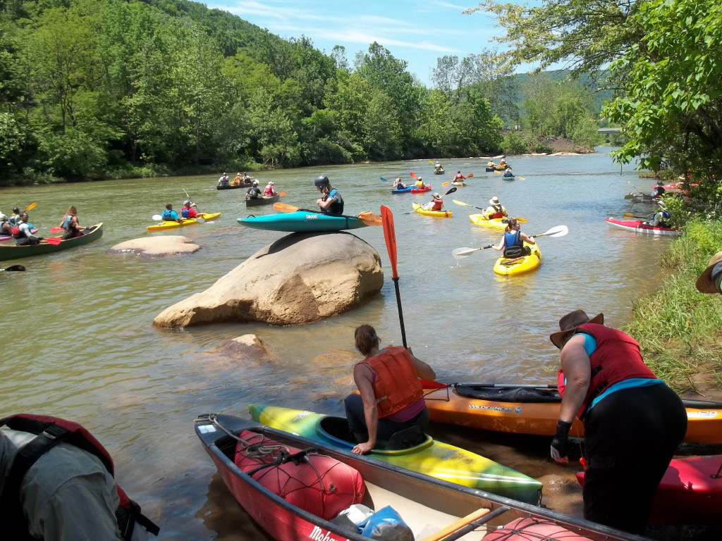
Central Park Suggestions
More ways to Connect with the River

Slide 27
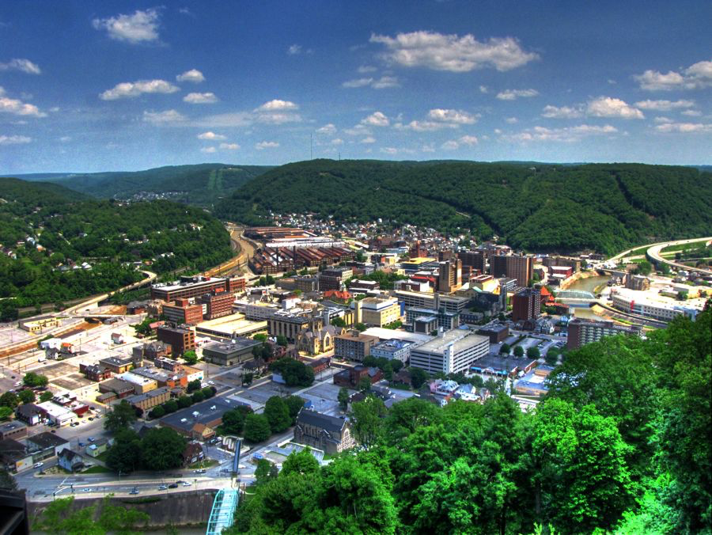
MOUNTAIN TOWNS
QUALITY OF LIFE INDEX
Notes:
Regions including:
Cumberland, MD
Altoona, PA
Pittsfield, MA
Burlington, VT
Roanoke, VA
Ashville, NC

Slide 28
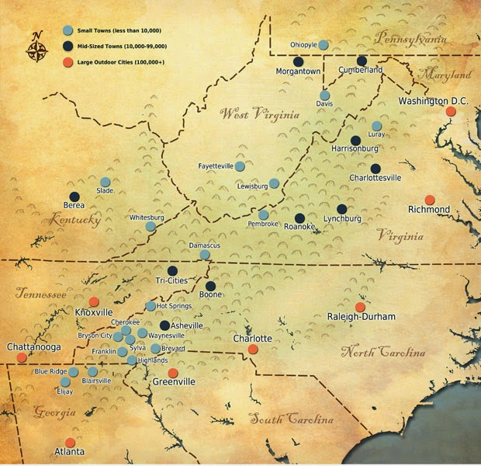
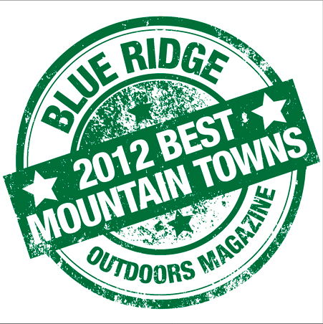
Johnstown
Altoona
Wheeling
2025
Staunton
15
Benchmark
Cities

Slide 29
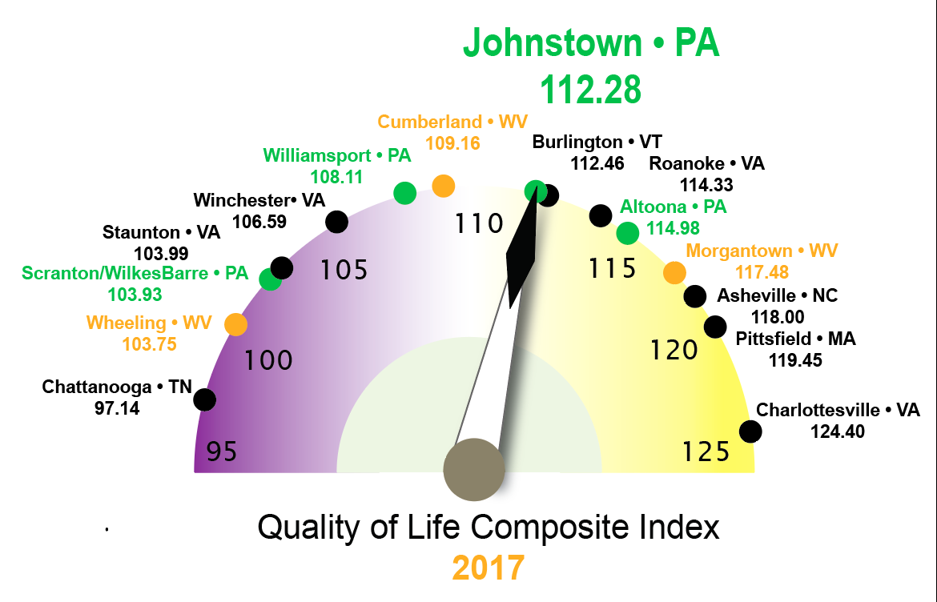
QUALITY OF LIFE • CITY COMPARISON
2017

Slide 30
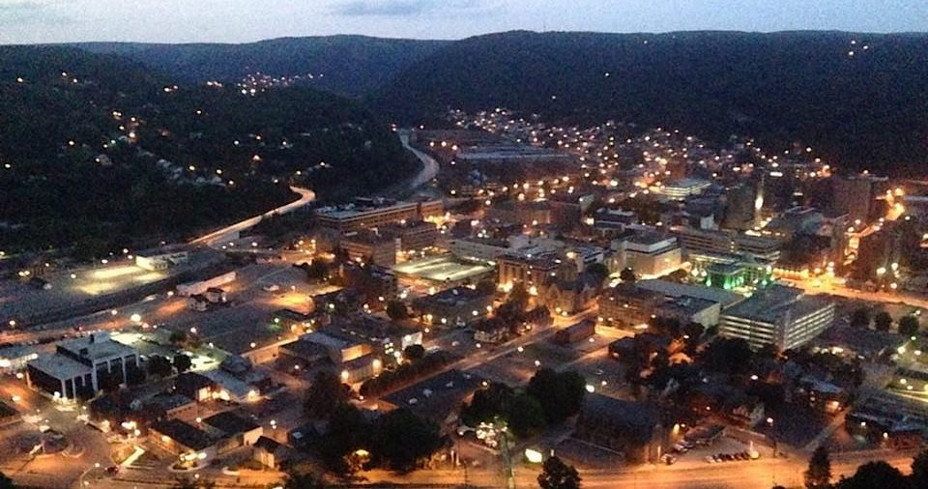
Did We Move the Needle?

Slide 31
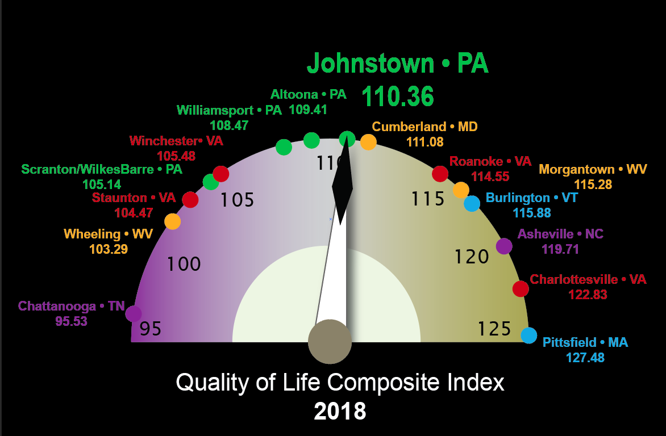

Slide 32


Slide 33
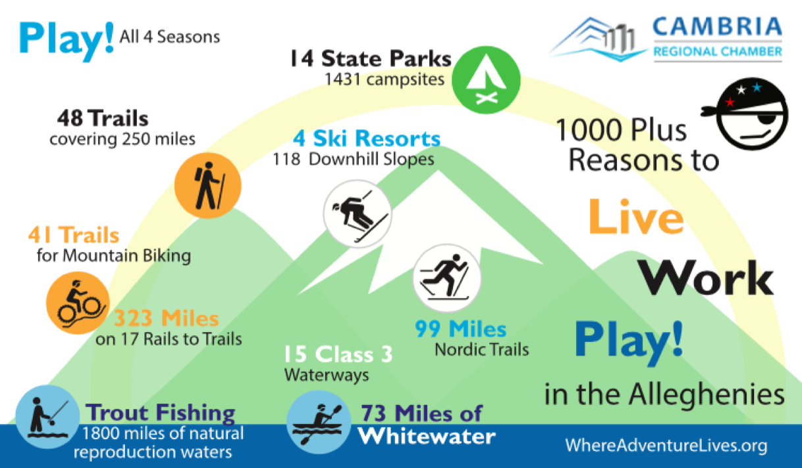
Your Rebel Card

Slide 34
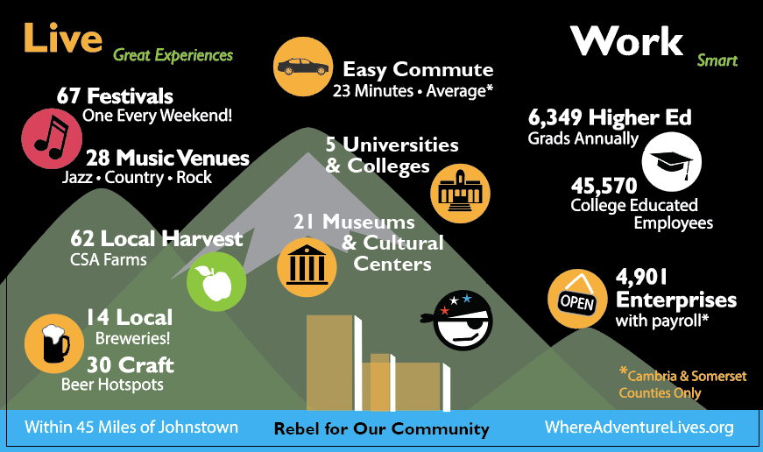
Your Rebel Card

Slide 35

Join the Rebellion
Join Us!
Are you in?

Slide 36
Rebel Manifesto
Always Think Out-of-the-Box
Never accept "No"
Honor our Heritage in Cool New Ways
Magnify our Town’s and Region’s Natural Assets
Jettison the Old Baggage that Hold us All Back
Tell Our New Story Well and Often

Slide 37

Little Changes

Slide 38
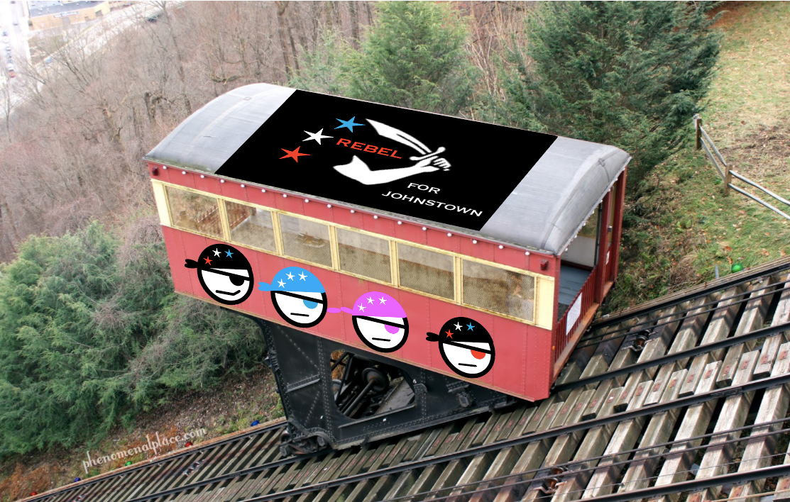

Slide 39


Sign the Manifesto
and Join the Rebellion!

Slide 41
?
Economic
Climate
Study
2018
?
?
Rogue Researchers:
John McGrath, Ph.D.
Skip Glenn
Research Assistant:
Edwin Kesslak
?

Slide 42
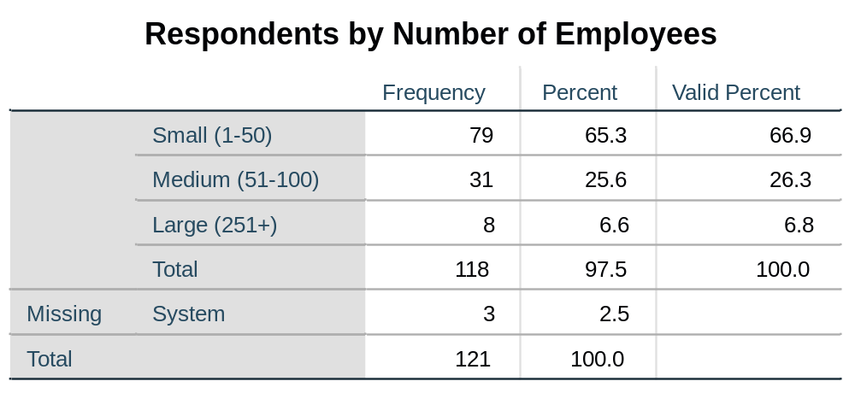
Appendix 1: Respondents by Number of Employees

Slide 43
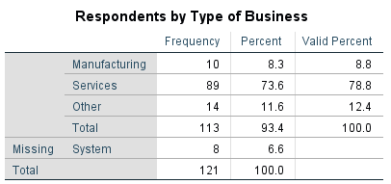
Appendix 2: Respondents by Type of Business

Slide 44
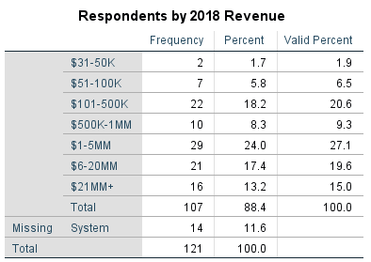
Appendix 3: Respondents by Revenue

Slide 45
Appendix 4: Historical Response Rate

Slide 46
OPTIMISM SCALE
…and a bit more
optimistic than
last year
Pessimistic
Moderately Optimistic
Very Optimistic
Our Region:
2017
13%
69%
18%
Our Region:
2018
60%
13%
27%

